Slide 1
Academic Reading & Writing
Unit 4: Computer/Paper Dictionaries and Language Acquisition
Methods Sections

Slide 2
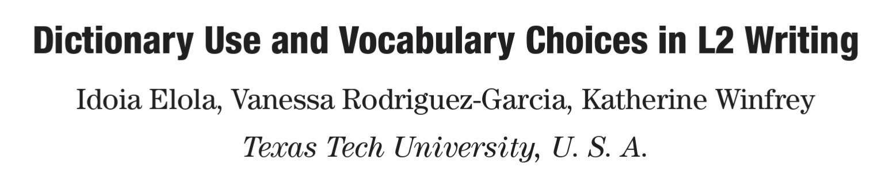
Last Week
We finished Unit 3 - we read the paper and discussed how to research and write Literature Reviews
This week we’ll talk about sourcing, review the Unit 4 literature review, and start Methods

Slide 3
Integrating Sources

Slide 4

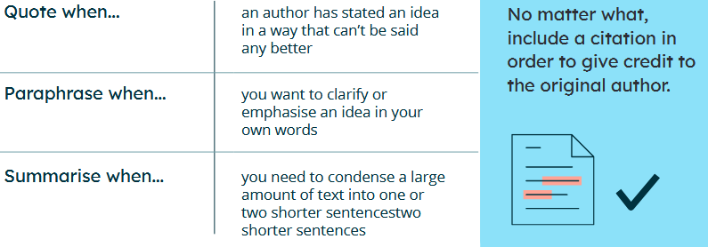

Slide 5
Quoting

Slide 6
Quoting
Use the exact words of another author
Place the exact words within quotation marks “”
Cite the source using your preferred method, including the page number
Use this method when:
You believe the original author says it best or paraphrasing hurts the meaning
You want to break up repetition or add some variety

Slide 7
Quotation Example From Reading
Online sources, then, become a resource tool where the main purpose can be “to prevent or at least reduce communication conflicts which may arise from lexical deficit” (Hartmann, 1987, p. 21).
Exact words
Citation
w/ Page #
Quotation marks
Page 82

Slide 8
Summarizing

Slide 9
Summaries
Summarizing is when you paraphrase a large amount of material in a few sentences, such as:
Overall conclusions
Repeated/recurring themes in the work
Entire chapters or sections
You can cite the entire work for these – no need to cite every page number

Slide 10
Example From The Reading
Page 73/74
Broad conclusion (from multiple papers) in one sentence
Thus, a learner’s specific stage of development influences the types of strategies used when looking up words: at a lower level of development, a learner will only be able to apply a lexical strategy, whereas at a more advanced level, a learner will engage in semantic lookup strategies (Hartmann, 1983; Laufer & Hadar, 1997).
Entire paper cited, rather than specific pages

Slide 11
Another Example
Entire paper cited, this time in the text
From a psychological perspective, as Vygotsky (1978) noted, the mind is related to the social context, and since language is related to the mind, language consequently depends on the social context.
Page 73

Slide 12
Paraphrasing

Slide 13
Methods of Paraphrasing
Use different vocabulary with the same meaning
Synonyms
Change parts of speech
Give definitions
Use different grammar
Use different structure
Change sentence order
Combine/split sentences
Page 92

Slide 14
A good paraphrase should…
Cite the original material
Specific ideas should be cited using a page number
Differ from the original
Any direct quotes need “ ”
There should be no quotation marks for most summaries
Page 92

Slide 15
What’s wrong?
Students frequently overuse direct quotation in taking notes, and as a result they overuse quotations in the final [research] paper. Probably only about 10% of your final manuscript should appear as directly quoted matter. Therefore, you should strive to limit the amount of exact transcribing of source materials while taking notes. Lester, James D. Writing Research Papers. 2nd ed. (1976): 46-47.
Students often use too many direct quotations when they take notes, resulting in too many of them in the final research paper. In fact, probably only about 10% of the final copy should consist of directly quoted material. So it is important to limit the amount of source material copied while taking notes.

Slide 16
Better Paraphrase
Students frequently overuse direct quotation in taking notes, and as a result they overuse quotations in the final [research] paper. Probably only about 10% of your final manuscript should appear as directly quoted matter. Therefore, you should strive to limit the amount of exact transcribing of source materials while taking notes. Lester, James D. Writing Research Papers. 2nd ed. (1976): 46-47.
In research papers students often quote excessively, failing to keep quoted material down to a desirable level. Since the problem usually originates during note taking, it is essential to minimize the material recorded verbatim (Lester 46-47).

Slide 17
What’s wrong?
Wines drunk at Greek tables did not always come from Greece itself. The wine snobbery of the time extolled the merits of wines from the slopes of Mount Lebanon, from Palestine, Egypt and Magna Graecia-Greater Greece, i.e., southern Italy. The ten litres a day drunk by the famous wrestler Milo of Croton was a wine famous in Calabria, where Milo lived: this wine, Ciro, is still made.
Wines drunk by Greeks were not always made in Greece itself. The wine snobs of that period celebrated wines from Mount Lebanon, Palestine, and Egypt. The famous wrestler Milo of Croton, who consumed ten liters of wine a day, drank wine made in Calabria outside of Greece; this wine, Ciro, is still made.

Slide 18
Better Paraphrase
Wines drunk at Greek tables did not always come from Greece itself. The wine snobbery of the time extolled the merits of wines from the slopes of Mount Lebanon, from Palestine, Egypt and Magna Graecia-Greater Greece, i.e., southern Italy. The ten litres a day drunk by the famous wrestler Milo of Croton was a wine famous in Calabria, where Milo lived: this wine, Ciro, is still made.
Although Greeks were picky about their wine, they enjoyed wine from outside Greece. Upstanding Greeks enjoyed wine from many of Greece’s local trading partners—including Palestine, Egypt and southern Italy. One story tells of the famous wrestler Milo of Croton, who consumed ten liters of foreign wine daily (Toussant-Samat 263)

Slide 19
Paraphrase Practice – Task 2
There are several sentences, expressions, and paragraphs on Page 98
Practice writing them in your own words
Once everyone has had enough time to write, we will listen to some examples for each sentence

Slide 20
The way to a male’s heart is through his tummy.

Slide 21
A penny saved is a penny earned.

Slide 22
You can’t teach an old dog new tricks

Slide 23
Haste makes waste

Slide 24
You can’t make a silk purse out of a sow’s ear.

Slide 25
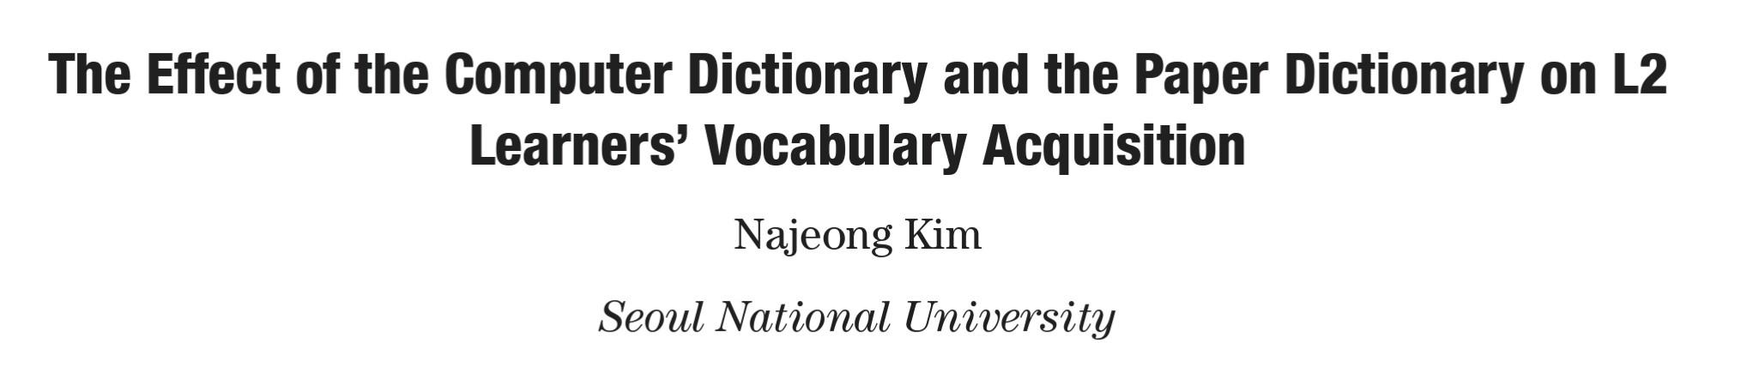
This Week’s Reading
This unit will review Literature Reviews and introduce Methods

Slide 26
The main aim of this study is to investigate the effect of the two different types of dictionaries, the computer dictionary and the paper dictionary, on L2 learners vocabulary acquisition while they read a text for comprehension.
Page 100

Slide 27
1.2 Previous research
1.2.1 Incidental vocabulary acquisition
It is widely agreed among language researchers that learners acquire most of their vocabulary while they read for comprehension. This secondary learning is referred to as incidental vocabulary acquisition because it occurs incidentally while learners try to understand the text rather than to acquire vocabulary (Krashen, 1989; Nagy, Andersen, & Herman, 1987). For the last few decades, incidental vocabulary learning has been supported by much evidence in L2 research field.
In spite of the evident role of reading on incidental vocabulary learning, however, many researchers and teachers have pointed out that learning vocabulary by reading has some limitations.
Page 100/101

Slide 28
To overcome these limitations, L2 researchers have suggested some complementary methods to enhance vocabulary learning while reading. They found that provision of glosses and dictionary consultation are effective to promote incidental vocabulary acquisition (Hulstijn, Hollander, & Greidanus, 1996; Knight, 1994; Luppesku & Day, 1993). Of the two methods, provision of glosses is limited to materials specialized for L2 learners, and thus dictionary use remains a general and useful tool for effective vocabulary learning. Therefore, this study will focus on dictionary use as an effective strategy to improve incidental vocabulary acquisition.
Page 101

Slide 29
1.2.2 Dictionary use while reading
1.2.2.1 The role of dictionary use on incidental vocabulary learning
A number of studies on dictionary use have been conducted to investigate the role of dictionary consultation on incidental vocabulary acquisition while reading. Many L2 researchers found that dictionary consultation enhances incidental vocabulary acquisition (Fraser, 1999; Hulstijn et al., 1996; Knight 1994; Laufer & Hill, 2000; Luppescu and Day, 1993).
Page 102

Slide 30
1.2.2.2 Comparison of the computer dictionary use and the paper dictionary use while reading
With the advent of computer technology, the computer dictionary appeared as a new convenient consulting device for L2 readers. The computer dictionary provides a different way of consultation to the users. Without flipping through pages and without looking for the spelling in alphabetical order which accompanies traditional dictionary use, electronic dictionary users can access the information in an instant by typing or clicking. (Sharpe, 1995; Nasi, 1996, 1999, 2000b). The advent of the computer dictionary inspired some research on the comparison of look-up behaviors of the computerized dictionary and the paper dictionary.
Page 103

Slide 31
1.2.3 Noticing hypothesis
It is widely accepted that incidental vocabulary learning takes place during reading. However, it seems thet not all the comprehensible input is likely to be available for further learning processes. In the field of L2 research, many researchers have explored how some parts of the input used for comprehension become activated to be processed further in language learning.
Page 103

Slide 32
Regarding this issue, Schmidt (1990, 1995, 2001; Schmidt & Frota, 1986, cited in Schmidt, 1990) proposed noticing hypothesis that for learners to learn some aspects of language, they must consciously notice them for any subsequent processing. That is, for input to be intake he claimed that noticing on the part of the learner is necessary. Schmidt defined intake as what Chaudron (1985) called preliminary intake, which means converting speech input into stored data that can be used for the construction of language, distinguishing from those used to organize stored data into linguistic systems (Schmidt, 1990, p. 139). […]
Page 103/104

Slide 33
[…] He argued strongly against any intake of input that the learner has not noticed. He meant the term noticing as one of the levels of awareness, at which stimuli are subjectively experienced and attention at the level of the availability of the verbal report. However, he admitted that stimulus events could be noticed even though it could not be describable. In addition, he emphasized the role of consciousness as crucial to all learning, adapting the view of psychology that conscious processing is necessary for permanent long term storage and anything not processed consciously is not stored in the long-term memory.
Page 104

Slide 34
1.3 Research questions
The first aim of this study is to confirm that the computer dictionary would increase learners look-up behavior more than the paper dictionary as found in previous comparison studies. Secondly, this study aims to investigate the effect of the computer dictionary and the paper dictionary on incidental vocabulary learning. According to the previous studies, it was found that dictionary consultation is effective in incidental vocabulary learning (Fraser, 1999; Hulstijn, Hollander, & Greidanus, 1996; Knight, 1994; Luppesku & Day, 1993) and that the computer dictionary encourages the users to look up more words than the paper dictionary (Nesi, 2000a; Roby, 1991)
Page 104

Slide 35
(Hulstijn, Hollander, & Greidanus, 1996)
(Hulstijn et al., 1996)
Hulstijn, J. H., Hollander, M., & Greidanus, T. (1996). Incidental vocabulary learning by advanced foreign language students: The influence of marginal glosses, dictionary use, and reoccurence of unknown words. The Modern Language Journal, 80, 327–339.

Slide 36
Based on these foundings, it is hypothesized that if a computer dictionary increases learners look-up behavior more than its paper counterpart, this will, in turn, result in a more positive effect on incidental vocabulary learning than a paper dictionary. Finally, the third objective of this study is whether the words looked up in the computer dictionary will be retained in memory as well as the words looked up in the paper dictionary. It is hypothesized that learners access the information too quickly and the easily searched words will not be retained in long-term memory.
Page 104

Slide 37
The research questions to be answered from this research are the following:
Do the computer dictionary users look up more words than the paper dictionary users?
(2) Is the electronic dictionary more beneficial to L2 learners’ incidental vocabulary acquisition than the paper dictionary?
(3) Is there any difference on the retention rate between the words looked up in the paper dictionary and the electronic dictionary?
Page 104

Slide 38
Questions
Is the literature review part of the Introduction?
How is the Literature Review structured? Does it also have the three parts we discussed last class?
How many times does the author state their purpose/aim? Do you think this is necessary?

Slide 39
Research Questions
What is a research question?
What are the research questions for this study?

Slide 40
Research Questions
Which of the following research questions is better? Why?
What can be done to prevent substance abuse?
What’s the relationship between specific early childhood experiences and subsequent substance abusing behaviour?

Slide 41
Word | Definitions
Target | Urge on or encourage
Complementary | Different from each other but making a good combination
Enhance | The complete duration of something
Inspire | A result that you are trying to achieve
Scrambled | Strengthen or make more firm
Confirm | Improve its value, quality, or attractiveness
Span | Earlier
Previous | Thrown together in a disorderly fashion
Page 115

